Slide 1
Welcome to MAS-DSE
Yoav Freund
Director

Slide 2




Analytics in a distributed retail chain The traditional model
(IT) Information Technology
(BA) Business Analytics
Data
Warehouse
Notes:
Add Animation

Slide 3



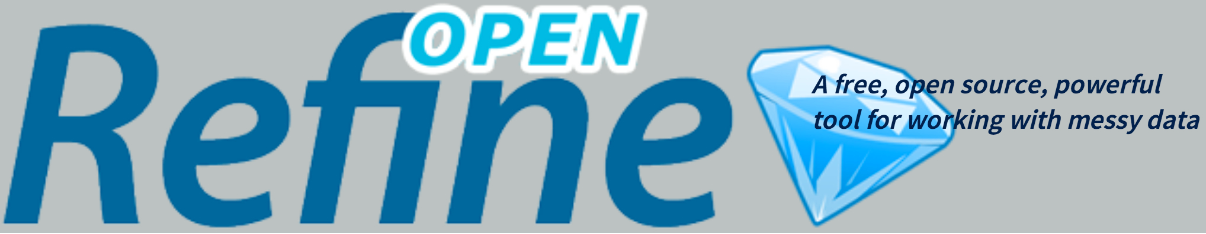

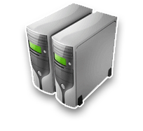
Analytics in a distributed retail chain The emerging model
The domain expert
The methods expert
Data & Virtual machines on the cloud
Notes:
Complete

Slide 4
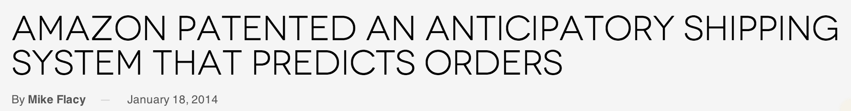
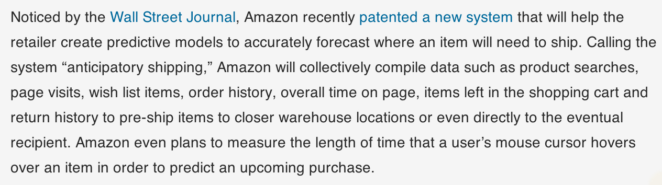
The power of predictive analytics
Actual patent: shipping a package without a final destination.
This method can only work when there are many identical orders from one location/city. Final address changed at UPS/USPS location.
Supply chain management is a long standing practice, amazon is bringing it to the next level.
Notes:
Expand into 2-3 slides with basic idea.

Slide 5
The education of a data scientist
Doing Data Science / Straight Talk from The Frontline / by Rachel Schutt & Cathy O’Neil
Math & Statistics
Knowledge
Hacking Skills
Machine
Learning
Data
Science
Danger
Zone!
Traditional
Research
Substantive
Expertise
Notes:
What is your strongest suites, what is your weakest?

Slide 6
Literate Computing
“Literate Programming” - Donald Knuth 1992. --- Programs should be easy to read.
“Literate Computing” - Fernando Perez, 2013: --- Data analysis should be easy to read.
Our Tool: Ipython notebooks.

Slide 7
DSE200 – Python for data analysis
Introduction to literate computing using a diverse, cloud-based, text-based, open-source, free and extendable framework.
A fast introduction to
Python
Unix / github
Pylab/numpy/scipy/pandas/matplotlib
Markdown
Using APIs (amazon, twitter, facebook, …)

Slide 8
Github
One of the largest public code repositories in the world.
Based on the git peer-to-peer version control system.
Mostly open, but MAS has some private respositories.
Each student will fork the master repository and will use their copy to store their work.
Our organization on GitHub: https://github.com/orgs/mas-dse/
What you need to do:
Create a github account, if you don’t have one already
Fill the form at xxx

Slide 9
AWS
The collection of cloud services provided by Amazon.
We have a organization account called mas-dse. You should have your own account in this organization.
Use the command LaunchNotebookServer.py –c Class1 to launch the notebooks for the first day.
We will have a look at the first notebook.
Please kill notebook when you are done for the day.
We will explain how to use github to save the work you have done.

Slide 10
A quick tour of the resources
Account on eng.ucsd
Class website
Git website (see frozen notebooks)
Live notebook

